Slide 1
Requirements and constraints
Short range (100-300 m between receivers)
Extremely simple transmitter design (lightweight, low power)
System can operate in cluttered environments (multipath interference)
System can operate with ~50 Txers
High spatial accuracy (~5 m) triangulation results
Low cost receivers (COTS components)
Low power consumption of receivers

Slide 2
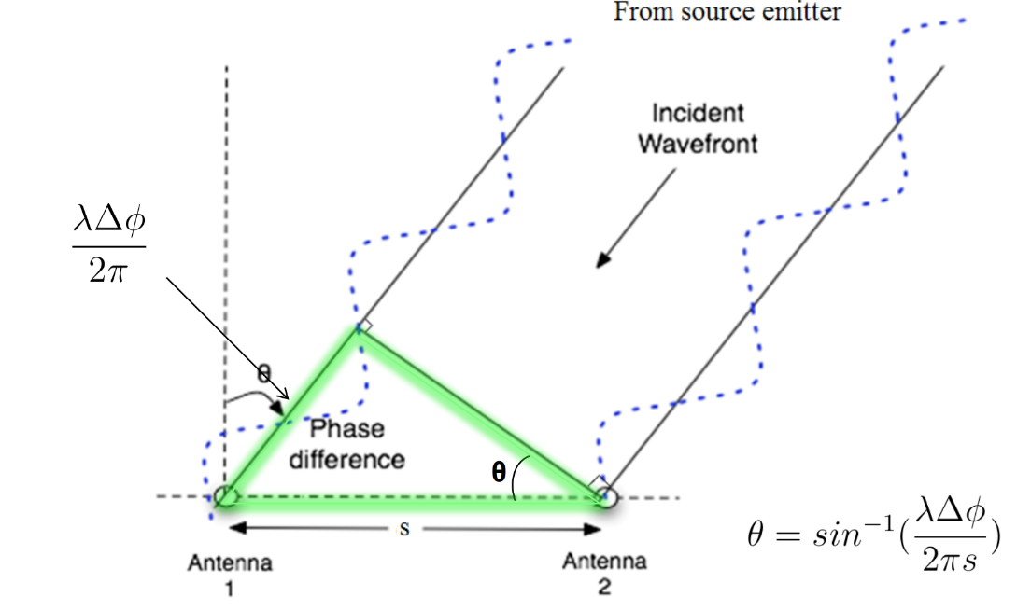
Phase Interferometry
Mei and Russell: Determine whether in-phase and quadrature info is available from CC1310. Solidify thinking about basic hardware setup
Local
Oscillator
Antenna 1
Mixer
CC1310
ADC
Antenna 2
Mixer
CC1310
ADC
DF Algorithm running on RaspberryPi
Antenna 3
Mixer
CC1310
ADC
Ideal adapted from
Lincoln Labs
Notes:
TDOA

Slide 3
Mei, Russell, (possibly Nathan): If I and Q are not available at CC1310 (unlikely), we need to modify the hardware setup.
How many antennas is enough?
CC1310
ID
Local
Oscillator
Antenna 1
Low Noise
Amplifier
CC1310 activates ADC when good link established?
i1
DF Algorithm running on RaspberryPi
Mixer / Demodulator
i2
ADC
Antenna 2
Low Noise
Amplifier
i3
q1
q2
q3
Antenna 3
Low Noise
Amplifier
Is there a 3+ channel demodulator, or do we need 2?
Is there a 6+ channel ADC, with sufficient bit-depth and sample rate, or do we need 2?
Notes:
TDOA

Slide 4
Problems for localization: Jamming
Rx1
F
2F
Tx1
Rx2

Slide 5
5 + X s
5 min – (5 + X s)
Tx
Rx from mobile nodes
5 s
X (?) s
Ground node
(acquire or sleep mode)
Tx countdown signal (5 s)
Tx commands
e.g. 3.9917 & checksum
e.g. 2.5628 & checksum
0.0000
Y IDs
Y commands
*Will need a data upload mode too
Checksum (opt.)
Global time
Sleep command
Y
Sleep length
X
Listen for tags
X
Y
X
N
Default?
N
Special commands for Y tags
*Give mobile nodes way to check that they have a good link
*All mobile nodes sync’d here
*Keeps all mobile nodes from TXing when system isn’t monitoring
*Default mode just has any tag within range of sync signal transmit at its scheduled time
*Special commands allow a subset of tags to be told to go to sleep, switch to different mode (e.g. to upload sensor data on different channel), etc.
Mobile node diagram to follow. Mobile nodes should sleep just under 5 s (ensuring they will hear a ground node transmission at least once if it is in range), then wake long enough to receive a single countdown signal from a ground node. Once they have received a countdown signal, and the checksum demonstrates a good link, update global time (it will have drifted over the last 5 min), then listen for rest of commands. Once commands received use global time, received command, and (assuming the command includes a simple transmit instruction) pre-programmed transmission time delay to send ID during the ground node’s ~5 min RX period.

Slide 6
Problems for localization: Ambiguity
?
Rx1
?
Ɵ +(n*π)
Tx1
Rx2

Slide 7
Problems for localization: Ambiguity
Rx1
π/2 +(3*π)
Tx1
π/2 +(3*π)
Rx2

Slide 8
Problems for localization: Ambiguity
Is triangulation inherently less precise than trilateration?
Rx1
Ɵ₁ =?= Ɵ₂
Tx1
Rx2

Slide 9
Problems for localization: Sensitivity
Rx1
Ideally isotropic
Realistically anisotropic
Tx1
Rx2

Slide 10
Problems for localization: Sensitivity
How many elements is enough?
Rx1
Tx1
Rx2
Rx3

Slide 11
Problems for localization: Multi-paths
Rx1
Ɵ₁==Ɵ₂ , Ɵ₁==Ɵ₂
Tx1
Rx2

Slide 12
Ground Nodes
Mobile Nodes
Energy harvesting + storage
Local
Oscillator
Where can we implement multiple frequency Tx?
How many freqs?
Can we stick w/ low freqs overall?
How separated?
Sequential Tx OK?
Alternatives (e.g. distributed calibration nodes)?
Antenna 1
Mixer/ Demodulator
CC1310
ADC
CC1310
Antenna 2
CC1310
ADC
DF Algorithm running on RaspberryPi
Matching network
Mixer/ Demodulator
Antenna 3
Mixer/ Demodulator
CC1310
ADC
Whip antenna
Notes:
TDOA

Slide 13
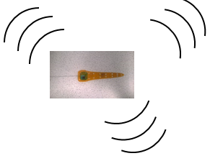

TRX 1
Peidong
Automated phase-based telemetry receiver system
TRX 2
Primarily Russell
Nathan
GPS
RxTx communication protocol
Nathan
Compass
Energy harvesting
Time-keeping,
coordination w/txrs
coordination w/ rxrs
localization of receivers
Julian
Orienting antenna elements
Julian
Node-to-node VHF uplink
TRX3
Triangulation algorithm
Uses RSSI?
Machine learning w/ calibration beacons?
TRX4
Bluetooth / VHF uplink to central hub
Primarily Mei

